Slide 1
THE SUNDAY REST BILL AND THE TRINITY

Slide 2
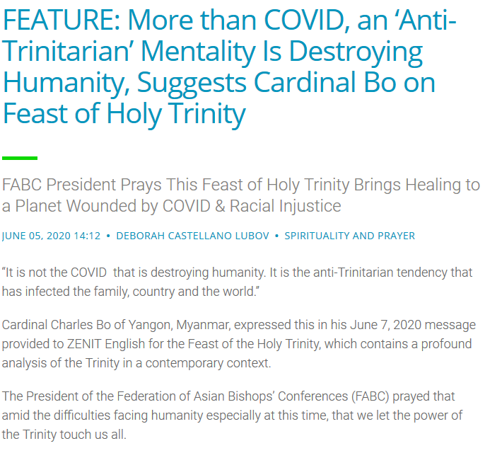
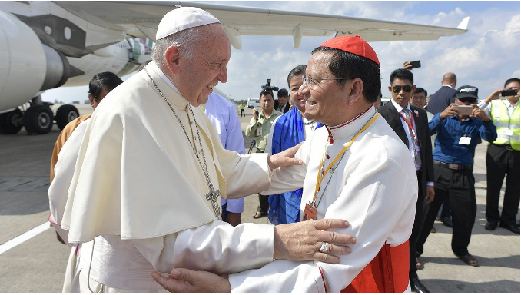

Slide 3
And what did our church pioneers say? ...
"It will also be noticed that this 'league' [The International Sunday Observance League] has other plans besides the intention to prosecute those who will not bow to their man-made Sabbath. Perhaps they will prosecute those who do not believe in the Trinity.“
(Review and Herald, Nov.20, 1894, Vol.71, No.46, p.730

Slide 4
We all know that Sunday laws are on the statute books of America, and many Seventh-day Adventists are waiting for the Sunday law to be enforced in fulfillment of the mark of the beast in Revelation 13. But what the majority of Seventh-day Adventists don't realize, is that attached to the Sunday law bills was another 'religious' law concerning the Trinity. Take a look at the following concerning the Breckinridge Bill, of which A.T.Jones and other Adventist leaders spoke against:

Slide 5
"Be it enacted by the Senate and House of Representatives of the United States of America in Congress assembled, That it shall be unlawful for any person or corporation, or employe of any person or corporation in the District of Columbia, to perform any secular labor or business, or to cause the same to be performed by any person in their employment on Sunday, except works of necessity or mercy; nor shall it be lawful for any person or corporation to receive pay for labor or services performed or rendered in violation of this act ...."

Slide 6
"...In this connection let me say, gentlemen, that the District of Columbia has just the same kind of a Sunday law as that of Ohio. This law of the District of Columbia was in force when this book was issued which I hold in my hand, which was April 1, 1868; and I am told that this law (which I will read) was re-enacted in 1874. I now quote from the law. Section 1 provides that-’ If any person shall DENY THE TRINITY, he shall, for the first offense, be bored through the tongue, and fined twenty pounds; ... and for the second offense, the offender being thereof convict as aforesaid, shall be stigmatized by burning on the forehead with the letter B, and fined forty pounds; and for the third offense, the offender being thereof convict asaforesaid, shall suffer death, without the benefit of the clergy.' Section l0 of the same law has this:-'No person whatever shall do any bodily labor on the Lord's day, commonly called Sunday ... Now, gentlemen, that law has never been repealed."(Arguments on the Breckinridge Sunday Bill -source)
http://www.end-times-prophecy.org/breckinridge-bill.pdf

Slide 7
"Taking this to some lawyers, they told us that the old law we had found was still binding.This is a very strict law, and provides that the offender shall pay a fine of 200 pounds of tobacco. But that which makes this law [Sunday law] appear so strange, is that it is found IN DIRECT CONNECTION with another statute which provides that any one who publicly denies the Trinity as commonly held, shall, for the first offense, have his tongue bored through, and for the third offense, suffer death without the benefit of the clergy. Possibly the reason why the promoters of the present Sunday law ignore the one now on the statutes, is because it is in the company of another law so barbarous in its make-up, thus showing the
nature of the company Sunday laws of the past have always kept."(Review and Herald, Jan.21, 1890, Vol.67, No.3, p.44 -

Slide 8
"There is now, on the statute-books of this District, an old Maryland law which has never been repealed, under which a person convicted of denying the Trinity, received the mark 'B' in his forehead [reading statute of date Oct. 26, 1723]."(Review and Herald, Feb.4, 1890, Vol.67, No.5, p.74

Slide 9
So what law on the statute books is in 'direct connection'to the Sunday rest bill? The law that anyone who publicly denies the trinity will be persecuted. And we know that according to Rome, Sunday is directly connected to their trinity god ... "every Sunday is devoted to the honor of the Most Holy Trinity, that every Sunday is sanctified and consecrated to the triune God."(source) ... "Question 1092. What is Sunday, or the Lord's Day in general? A. It is a day dedicated by the Apostles to the honour of the most holy Trinity."(The Douay Catechism of 1649)

Slide 10
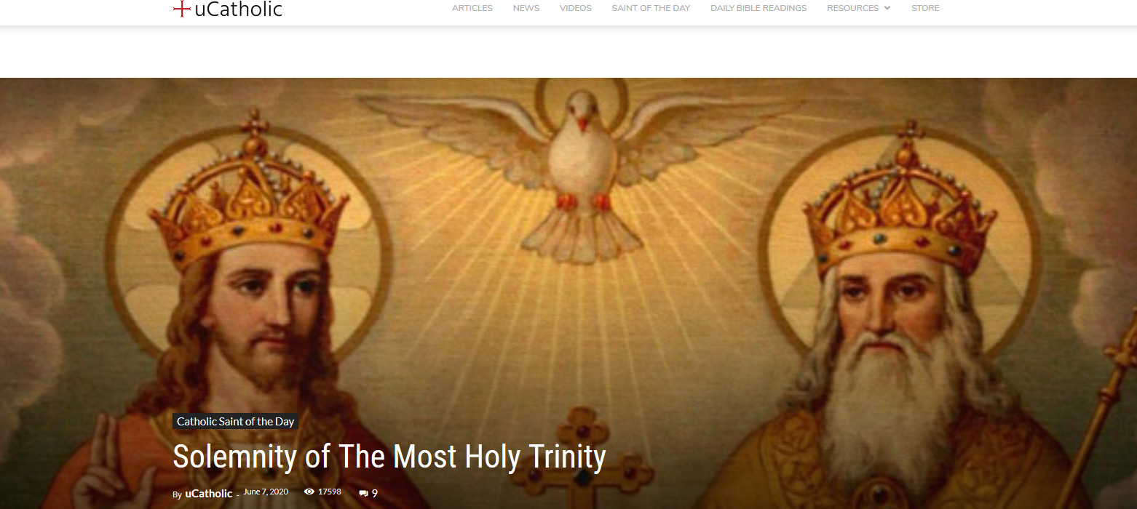
https://ucatholic.com/saints/holy-trinity-sunday/

Slide 11
https://www.catholicculture.org/culture/liturgicalyear/calendar/day.cfm?date=2020-06-07

Slide 12
And what are all the churches uniting on today? THE TRINITY! Take a look at our ECUMENICAL GOD OF ROME page for more information on that. So Rome is uniting all the churches on it's Trinity god ready for the mark to be enforced!

Slide 13
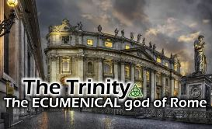
We can all see the ecumenical movement that is being pushed now, how the churches are coming together and uniting back with the Roman Catholic Church. Now many of these churches will tell you openly that there are still differences between them. So the question is, what is
the 'glue' that brings these churches together in unity? Take a look at the following quotes:

Slide 14
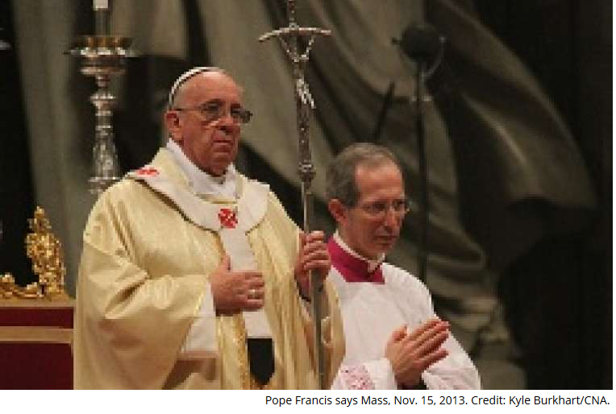
Vatican City, Jan 18, 2014 / 12:06 pm MT ().- Pope Francis met this week with members of an ecumenical delegation of Finnish Lutherans, encouraging them to work towards unity among all Christians.
"Pope Francis says that ecumenism is a spiritual process rooted in the trinity."

Slide 15
"Does Trinitarian reflection play a significant role in ecumenical dialogue? ... David Fergusson shows how the agreement of Christians regarding the doctrine of the trinity has stimulated efforts to extend this agreement to other areas of faith and practice (doctrinal, liturgical, and moral) informed by Trinitarian reflection." (The Oxford Handbook of the Trinity)
https://www.oxfordhandbooks.com/view/10.1093/oxfordhb/9780199557813.001.0001/oxfordhb-9780199557813-e-1

Slide 16
"The central ecumenical importance of the doctrine of the Trinity has become increasingly recognized in recent years." (MATTHIAS HAUDEL, professor of theology at Munster Protestant Theological University, Germany)
https://www.questia.com/library/journal/1G1-81111085/the-relation-between-trinity-and-ecclesiology-as-an

Slide 17
The "Global Christian Forum" states that to be part of their ecumenical movement, you need to "confess the triune god"
http://www.globalchristianforum.org/statement.html

Slide 18
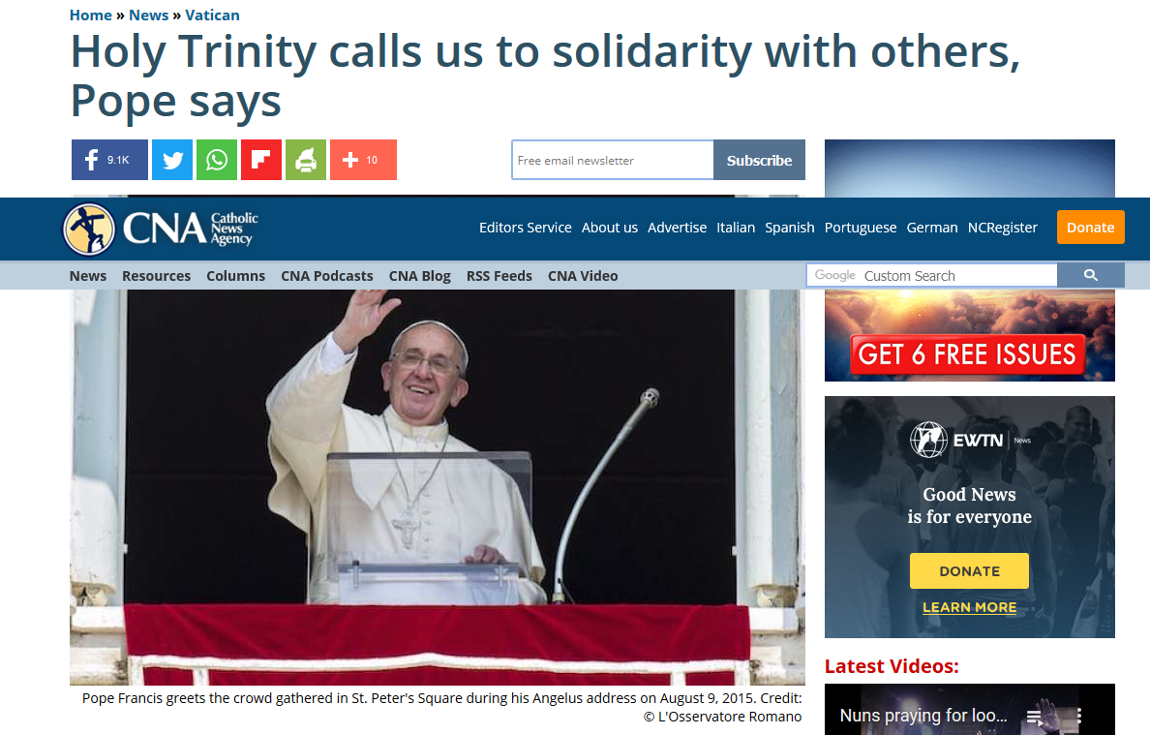
"The Trinity calls us to solidarity with others" (Pope Francis)
https://www.catholicnewsagency.com/news/holy-trinity-calls-us-to-solidarity-with-others-pope-says-76821

Slide 19
Now attached to the Sunday law bill in Ohio, we find the following exemption ... "The proviso of the Sunday law exempts those only who conscientiously observe the seventh day of the week as the Sabbath." (Arguments on the Breckinridge Sunday Bill, [see source above]). So 7th day Sabbath keepers would be exempt. But those who deny the trinity would be punished! Do you see the deception of Rome? Is this going to factor into the coming Sunday law? We will see. But the fact shows that this is not just about the Sunday law, as the trinity god of Rome is closely connected to it.

Slide 20
"Now what more was ever required by the papacy, and all phases of the old order of things, than is thus brought within the meaning of the national Constitution by this decision? What more was ever required by the papacy itself than that "the Christian religion" should be the national religion; that the discipline of the Church should be maintained by the civil power; that the religious test oath should be applied to all; that the public should be taxed for the support of religion and religious worship; that there should be required a belief in the doctrine of the Trinity, and the inspiration of the "Holy Scriptures of the Old and New Testament;" that the guilt of 'blasphemy' should be visited upon everyone who should speak or act 'in contempt of the religion professed by almost the whole community;' and that everybody should be required by law to observe Sunday? Indeed, what more than this could be required or even desired by the most absolute religious despotism that could be imagined?" (A.T.Jones, Ecclesiastical Empire, pp.837-838)

Slide 21
Remember, you can be a "Saturday keeper" and still be worshipping the beast by accepting the mark OR name, OR number of the beast. It is imperative that we stand on the truth of God's Word, and NOT follow the teachings of men. Let us be followers of Jesus Christ, not man!

