Slide 1
Indonesian SDA Church
Spirit Of Prophecy Department
2023

Slide 2
Warnings and reproofs from the Testimonies/Spirit Of Prophecy first of all it’s given to us (SDA Church).
Do you know why?
Notes:
Peringatan-peringatan dan teguran-teguran dari Kesaksian-kesaksian itu atau Roh Nubuat pertama-tama diberikan kepada kita (Gereja Masehai Advent Hari Ketujuh). Anda tau mengapa?

Slide 3
Testimonies for the Church, vol. 5, Page 661,662
Warnings and reproofs are not given to the erring among Seventh-day Adventists because their lives are more blameworthy than are the lives of professed Christians of the nominal churches, nor because their example of their acts are worse than those of the Adventists who will not yield obedience to the claims of God's law, but because they have great light, and have by their profession taken their position as God's special, chosen people, having the law of God written in their hearts.

Slide 4
4 Testimonies, 147-148
“In ancient times God spoke to men by the mouth of prophets and apostles. In these days He speaks to them by the testimonies of His Spirit. There was never a time when God instructed His people more earnestly than He instructs them now concerning His will and the course that He would have them pursue.”—

Slide 5
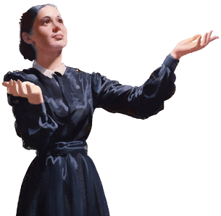
Colporteur Ministry, p. 127
“The very last deception of Satan will be to make of none effect the testimony of the Spirit of God. "Where there is no vision, the people perish" (Prov. 29:18). Satan will work ingeniously, in different ways and through different agencies, to unsettle the confidence of God’s remnant people in the true testimony.”

Slide 6
1. Daily Reading of Spirit of Prophecy
Reading Spirit Of Prophecy books will help to nurture our spiritual life, strengthen our relationship with Jesus, and deepen our trust in His Written Word. In this way we will become more like Him in character and purpose, transforming life style, and increasing our involvement with the life and mission of the church through the power and leading of the Holy Spirit. Therefore, it is the goal of the Spirit of Prophecy department so that each family/church members regularly studied as a supplement to the study of the Bible.

Slide 7
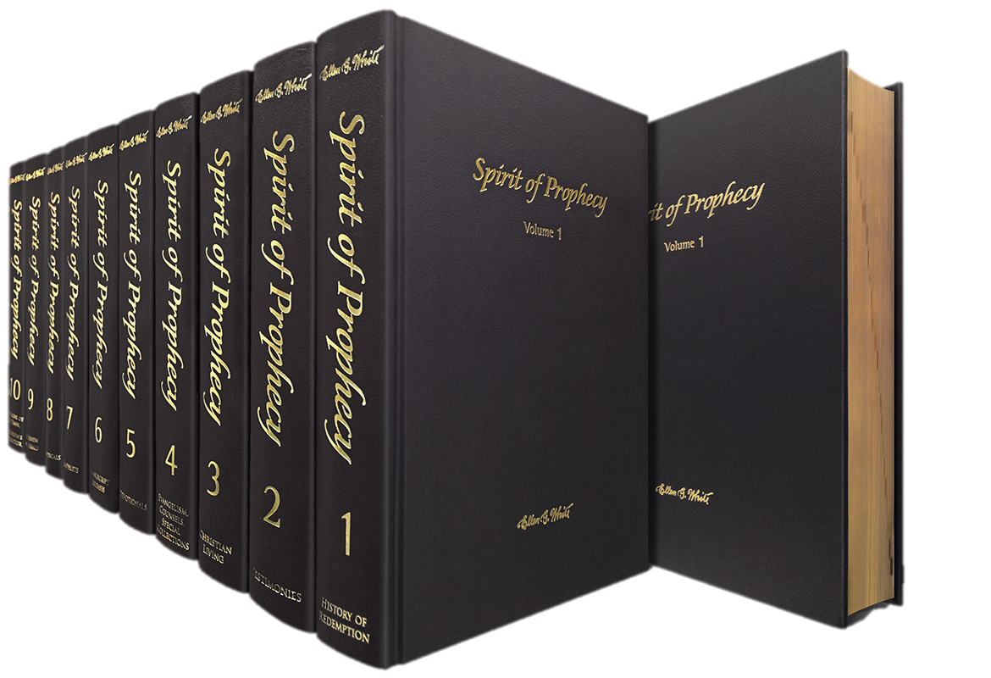
2. Sharing Spirit Of Prophecy
Books
Website:
http://indonesiansdachurch.adventistchurchconnect.org/

Slide 8
Colporteur Ministry, p. 123
This is the “Instruction has been given me that the important books containing the light that God has given regarding Satan’s apostasy in heaven should be given a wide circulation just now; for through them the truth will reach many minds.”

Slide 9
Colporteur Ministry, p. 127
“The Great Controversy should be very widely circulated. It contains the story of the past, the present, and future… I am more anxious to see a wide circulation for this book than for any others I have written; for in The Great Controversy, the last message of warning to the world is given more distinctly than in any of my other books.”

