Slide 1
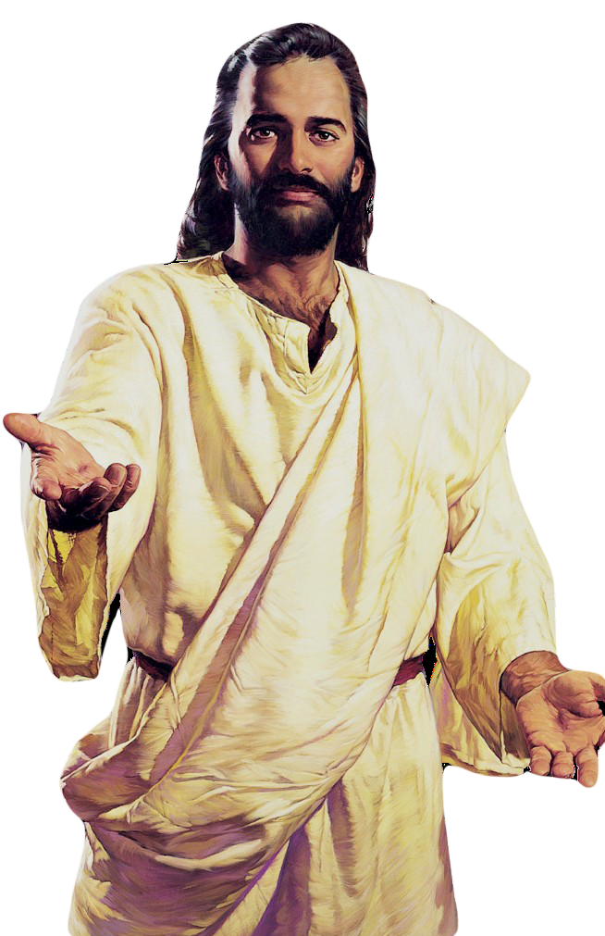
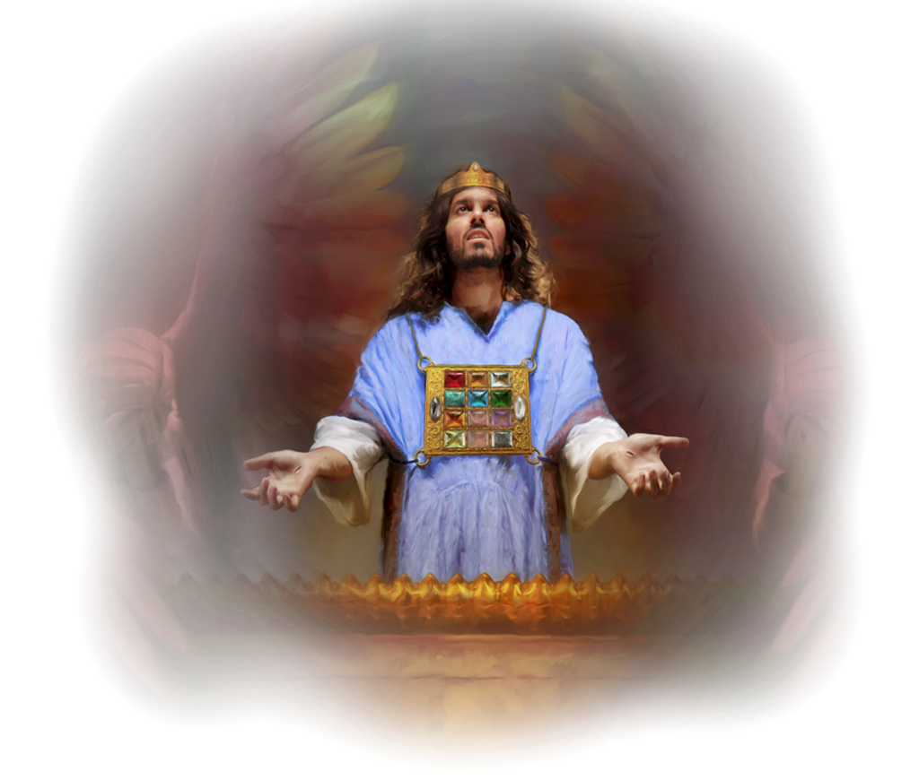
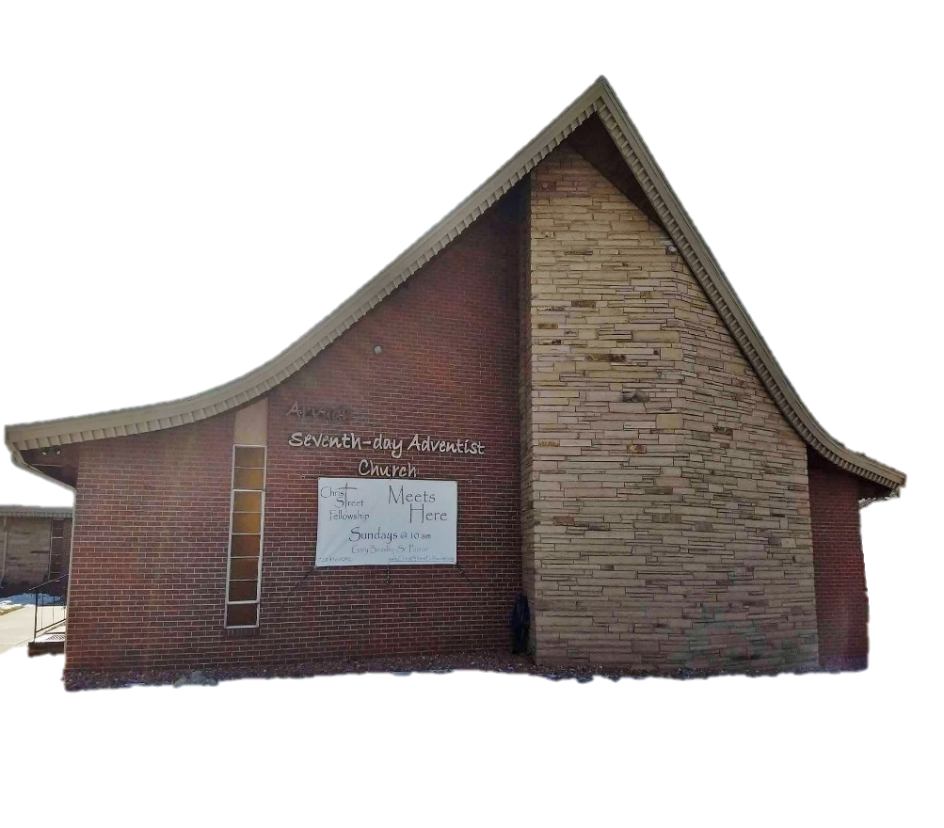
Now, Dear Lord, As We Pray
Sabbath, May 21st, 2022
7090 W 64th Avenue, Arvada, CO 80003 Website: isdacusa.org
Remember ………..
Welcome
Now, dear Lord, as we pray,
Take our hearts and minds far away
From the press of the world all around
To You Throne where grace does abound.
May our lives be transformed by Your Love, May our souls be refreshed from above,
At this moment, let people everywhere Join us now we come to You in prayer.
God’s Word
to
“Be My little children, these things I write to you, so that you may not sin. And if anyone sins, we have an Advocate with the Father, Jesus Christ the righteous.And He Himself is the propitiation for our sins, and not for ours only but also for the whole world.”
1 John 2:1,2
Indonesian SDA Church
-ISDAC-
Kusiapkan Hatiku Tuhan
Kusiapkan Hatiku Tuhan
Tuk dengar Firman-Mu saat ini Ku sujud menyembah-Mu Tuhan Masuk hadirat-Mu saat ini
Curahkan urapan-Mu Tuhan Bagi jemaat-Mu saat ini Kusiapkan Hatiku Tuhan Tuk dengar Firman-mu
Firman-Mu Tuhan tiada berubah
Dahulu sekarang selama-lamanya tiada berubah Firman-Mu Tuhan penolong hidupku
Kusiapkan hatiku Tuhan tuk dengar Firman-Mu
Jesus said, “I AM the way, the truth, and the life: no man comes to the Father, but by Me.” John 14:6
Happy Sabbath! We are greatful you have come to be with us today. It is our hope you experience the Love of Christ and His Presence during our worship
It is the Mission of the Indonesian SDA Church(ISDAC):
People in charge:
Church Officer 2022
Senior Pastor: Dr. Gordon Anic
Indonesian Pastor: Ps. Jani Pungus
Youth Pastor: Pst. Hevel Ryan Tumbarante
Elder: Anggia Sibuea
Elder: Frangky Lumowa
Elder: Jill Wullur
Elder: Stevy Kolibu
Secretary: Edward Winokan
Treasurer: Yooke Longkutoy
This Sabbath:
Elder: Frangky Lumowa(Front) and Jill Wullur(Back)
Deacons: Rully Maringka and Eldridge Woy.
Greeters: Tiffany Kolibu and Abbygaile Waworoendeng.
Chorister: Senny Lumowa
Next Sabbath:
Elder: Jill Wullur(Front) and Stevi Kolibu(Back)
Deacons: Matthew Winokan and Sky Pungus.
Greeters: Sherly Longkutoy and Laura Woy.
Chorister: Peggy Kaunang
To Know Jesus Fully
To Reflect His Character Clearly and
To Share His Message Joyfully

Slide 2
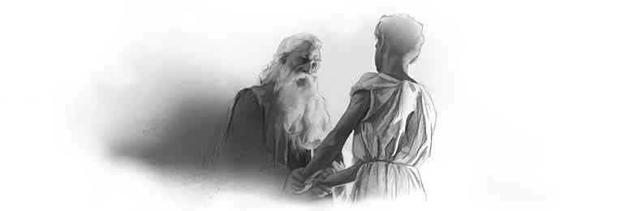
The Church At Study
10:00 AM
The Church At Worship
11:30 AM
The Indonesian SDA Church desires today you will experience the Love of Jesus Christ, and the “Blessed Hope” of His soon return. Thank you for sharing this Sabbath Day with us. If you’re looking for a Spiritual Home, we invite you to join our church family.
May 21st, 2022
Frangky Lumowa
Anggia Sibuea
LS # 2
Anggia Sibuea
SDA Hymnal #271
Deldijanto Kindangen
Joshua Munaiseche
Jenner Kolibu
Sky Pungus
Pst. Ryan Tumbarante
SDA Hymnal # 493
Chorister: Senny Lumowa
Pst. Ryan Tumbarante
SDA Hymnal #214
Announcements
Tithe and Offering
Kepada Allah Bri Puji
Offertory Prayer
Now Dear Lord As We Pray
Intercessory Prayer
Hear Our Prayer O Lord
Children Story “ Joshua”
Special Song
Theme Verse John 4:39,41-42
Praise Team
Ku Siapkan Hatiku Tuhan
Sermon “Will You Still Love Me”
Closing Song “Fill My Cup Lord”
Benediction
Response “We Have This Hope”
“The Promise”
Announcements
POTLOCK – Everyone is invited to stay for the fellowship meal immediately following the church service.
MID-WEEK PRAYER – Mid-Week prayer next Wednesday,April May 25th,2022 At 7:30 PM – the Word of God will be brought to us by Aaron Sibuea.
VESPER – Next Friday Vesper May 27th, 2022 At 07:30 PM – the Word of God will be brought to us by Jill Wullur.
NEXT SABBATH – Sabbath, May 28th, 2022 the Word Of God will be brought to us by Pst. Jani Pungus.
Memory Text:
“Now Abraham was old, well advanced in age; and the LORD had blessed Abraham in all things” (Genesis 24:1, NKJV).
“Adapun Abraham telah tua dan lanjut umurnya, serta diberkati TUHAN dalam segala hal.." (Kejadian 24:1, TB)
A storm is coming, relentless in its fury. Are we prepared to meet it? {8T 315.2}
We need not say: The perils of the last days are soon to come upon us. Already they have come. We need now the sword of the Lord to cut to the very soul and marrow of fleshly lusts, appetites, and passions. {8T 315.3}
Minds that have been given up to loose thought need to change. "Girding up the loins of your mind, be sober and set your hope perfectly on the grace that is to be brought unto you at the revelation of Jesus Christ; as children of obedience, not fashioning yourselves according to your former lusts in the time of your ignorance: but like as He who called you is holy, be ye yourselves also holy in all manner of living; because it is written, Ye shall be holy; for I am holy." 1 Peter 1:13-16, A. R. V. The thoughts must be centered upon God.
Now is the time to put forth earnest effort to overcome the natural tendencies of the carnal heart. {8T 315.4}
Our efforts, our self-denial, our perseverance, must be proportionate to the infinite value of the object of which we are in pursuit. Only by overcoming as Christ overcame shall we win the crown of life. {8T 315.5}
Fearful tests and trials await the people of God. The spirit of war is stirring the nations from one end of the earth to the other. But in the midst of the time of trouble that is coming,--a time of trouble such as has not been since there was a nation,--God's chosen people will stand unmoved. Satan and his host cannot destroy them, for angels that excel in strength will protect them. {9T 17.1}
Frangky Lumowa
Jacgueline Manueke
SDA Hymnal # 518
Chorister: Senny Lumowa
Leo Tilon
Jeanne Singon
Celine Lumowa
Adrie Singon
Deldijano Kindangen.
Zoom: Ellon T. English Class: Pst. Ryan T.
Edward Winokan
Welcome
Leader
Opening Hymn “Standing on the Promises”
Bible Reading/Opening Prayer
Family
Mission Story
Lesson Study “The Promise”
Personal Ministry
Thank You for worshiping with us today!
Sabbath rest ends today at 8:13 PM
Welcome next Sabbath at 8:18 PM

