Slide 2
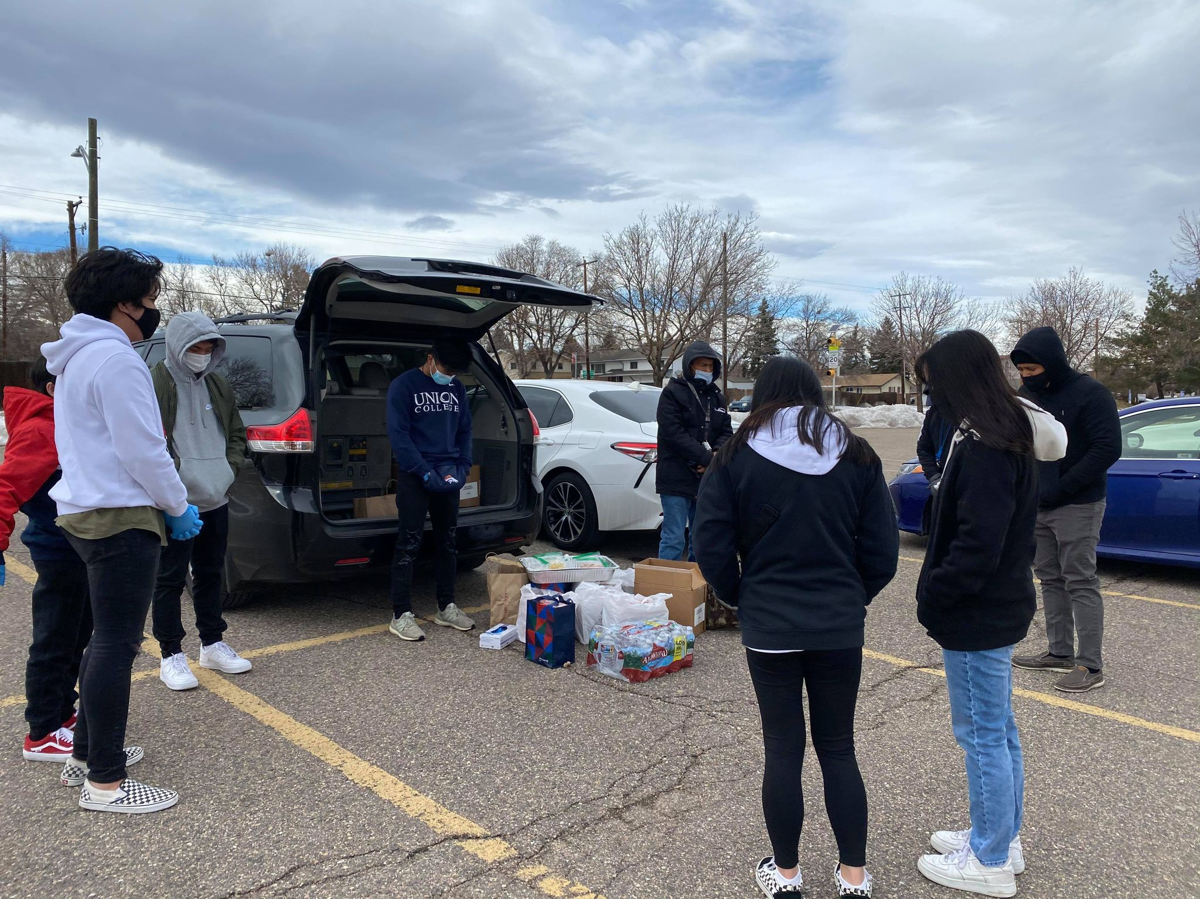

Slide 3
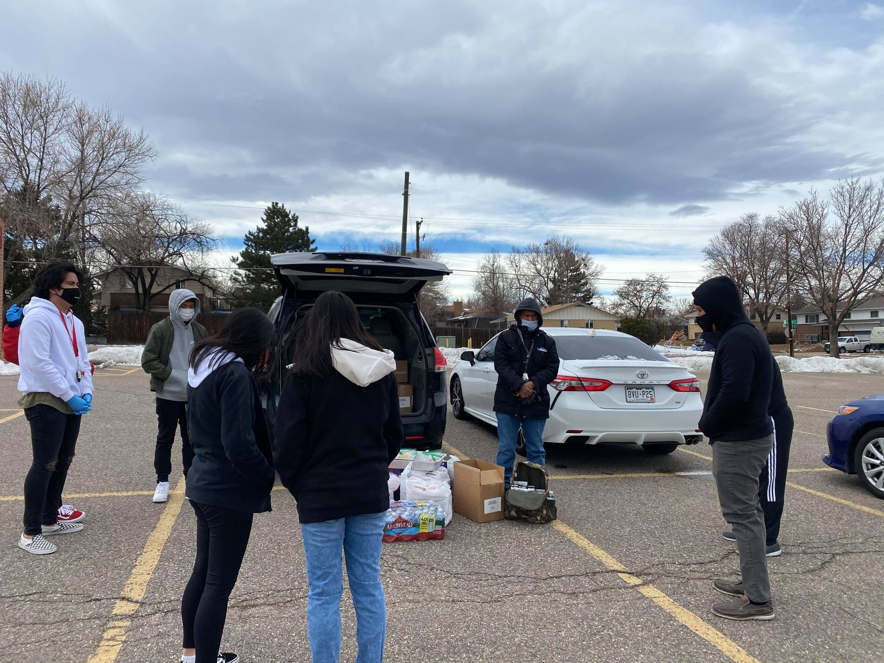

Slide 4
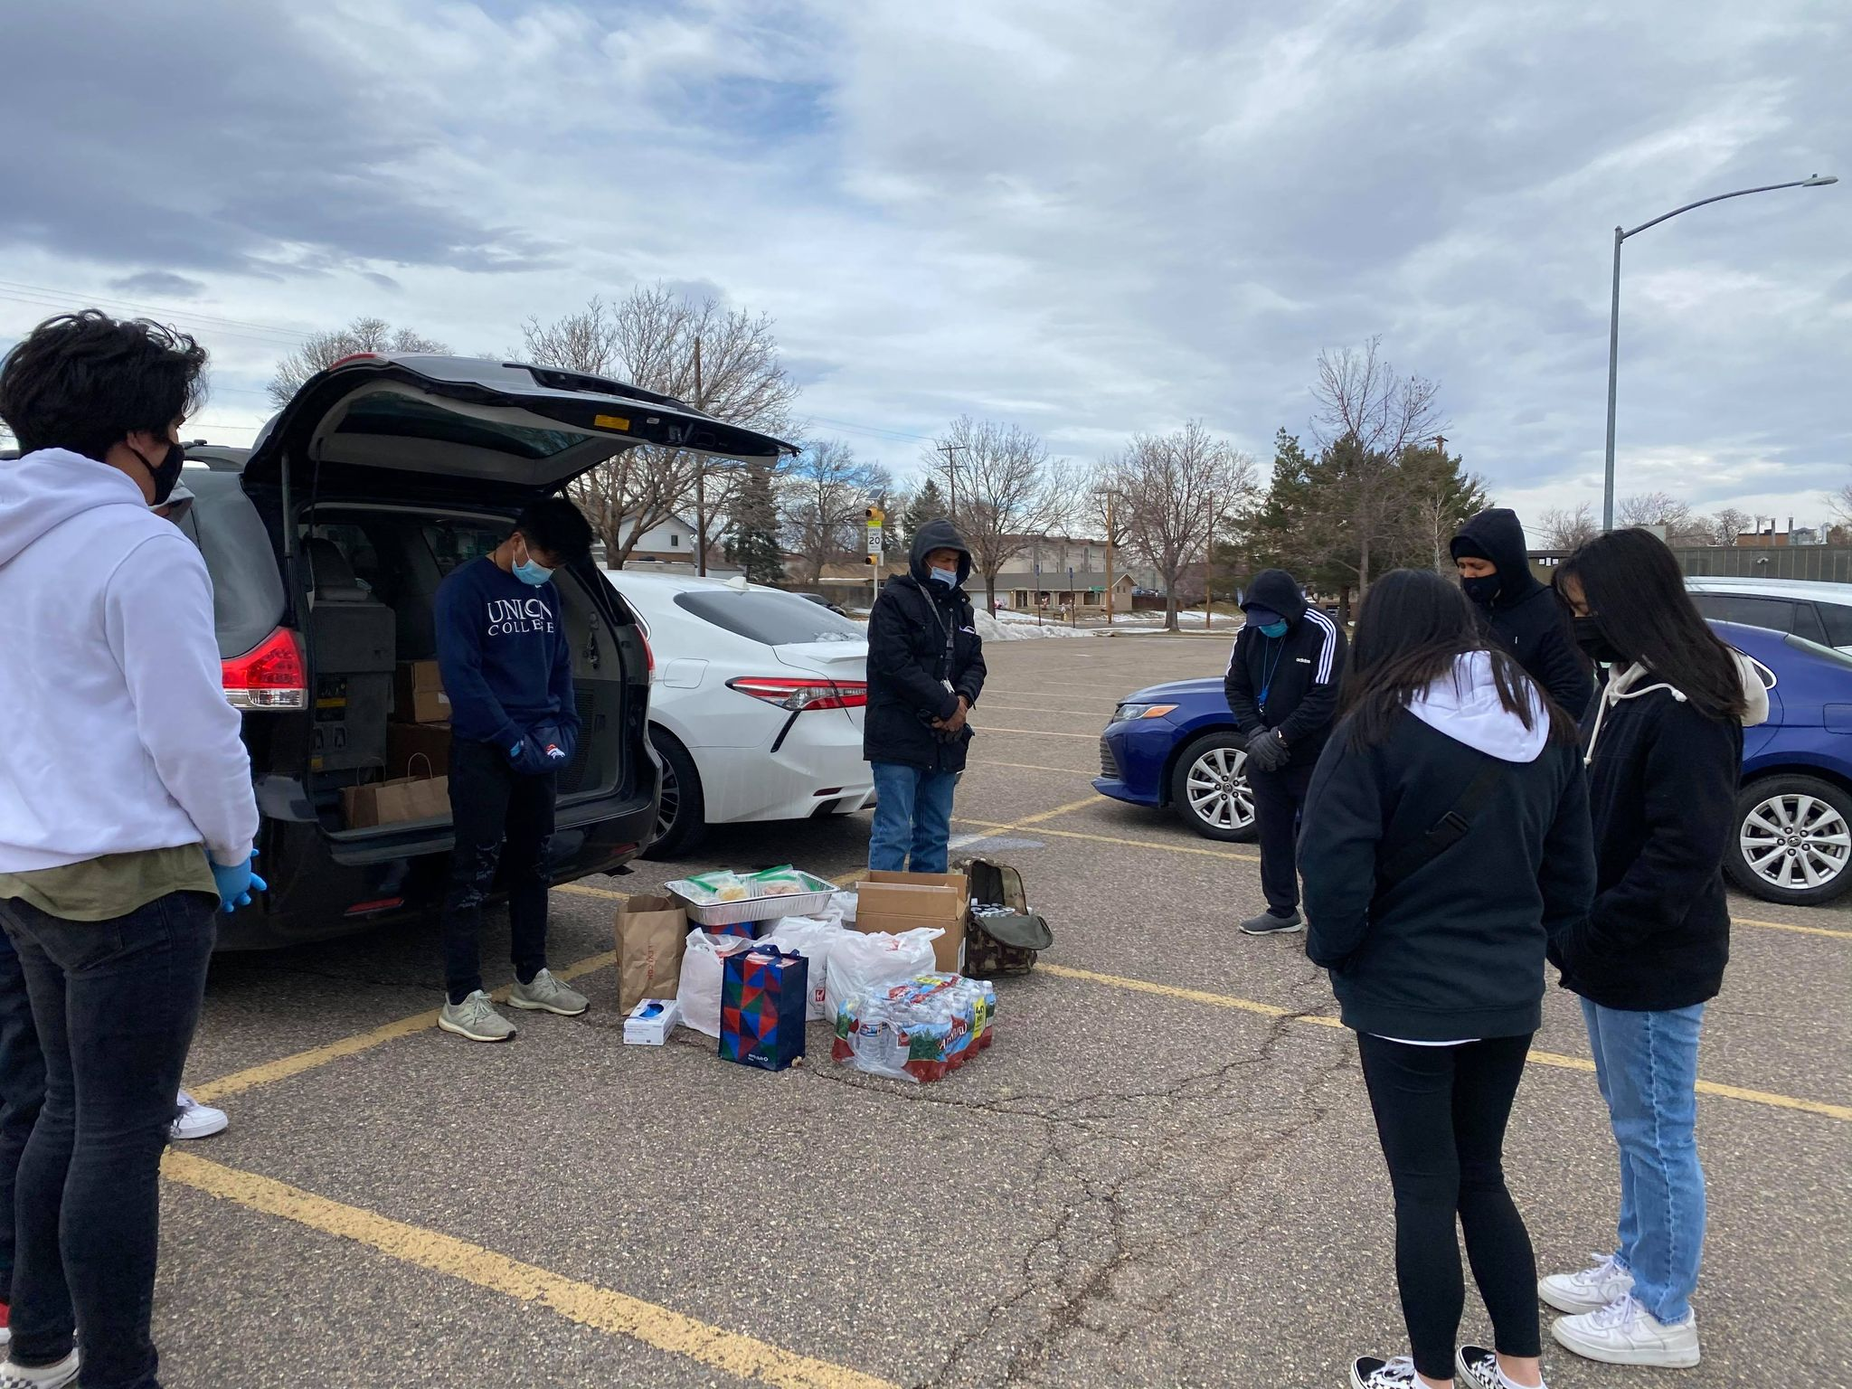

Slide 6
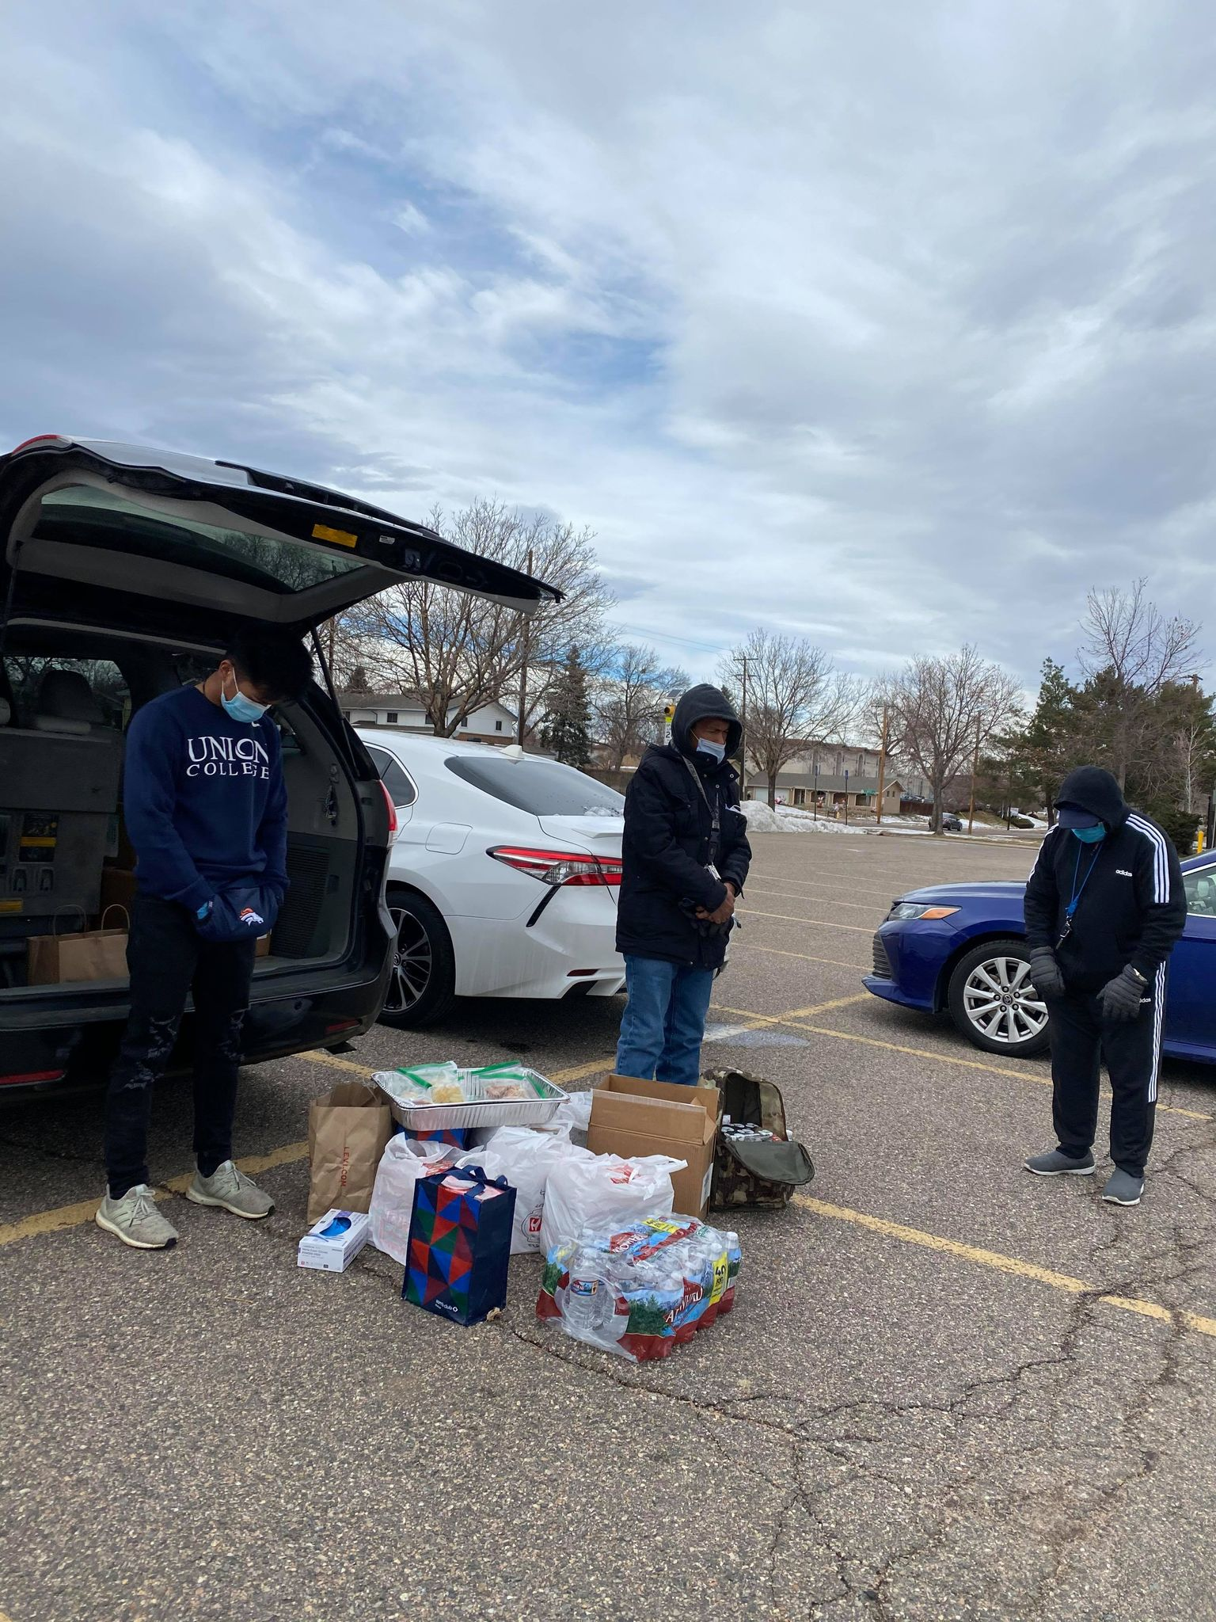

Slide 7
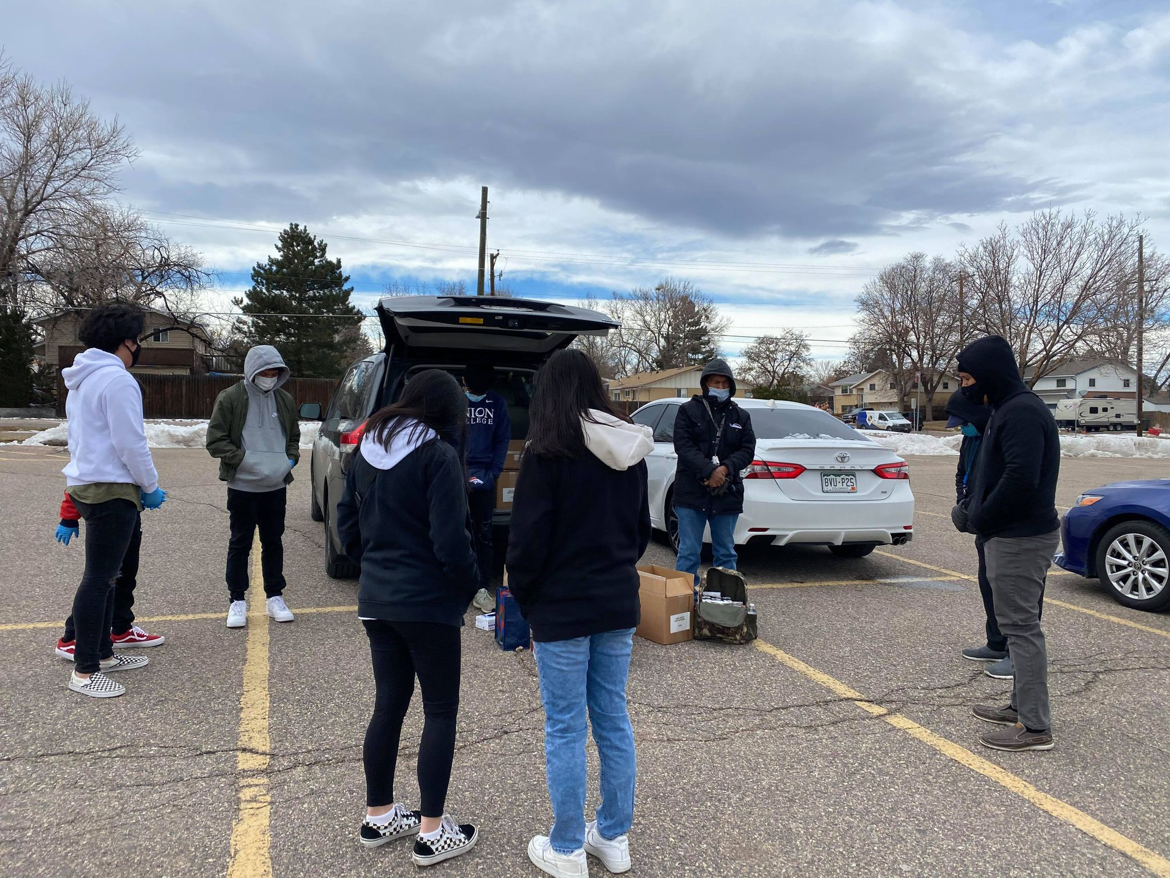

Slide 8
GREATEST RESULTS IN THE FUTURE

Slide 9
“The results of the circulation of this book [The Great Controversy] are not to be judged by what now appears. By reading it, some souls will be aroused, and will have courage to unite themselves at once with those who keep the commandments of God. But a much larger number who read it will not take their position until they see the very events taking place that are foretold in it. The fulfillment of some of the predictions will inspire faith that others also will come to pass, and when the earth is lightened with the glory of the Lord, in the closing work, many souls will take their position on the commandments of God as the result of this agency.”—Manuscript 31, 1890 [Colporteur Ministry, 128-129].

